Slide 1
MongoDB MapReduce

Slide 2
MapReduce
In MongoDB, map-reduce is a data processing programming model that helps to perform operations on large data sets and produce aggregated results.
It provides the mapReduce() function to perform the map-reduce operations.
This function has two main functions, i.e.,
map function and
reduce function.
The map function is used to group all the data based on the key-value and the reduce function is used to perform operations on the mapped data.

Slide 3
MapReduce
So, the data is independently mapped and reduced in different spaces and then combined together in the function and the result will save to the specified new collection.
This mapReduce() function generally operated on large data sets only. Using Map Reduce you can perform aggregation operations such as max, avg on the data using some key and it is similar to groupBy in SQL.
It performs on data independently and parallel

Slide 4
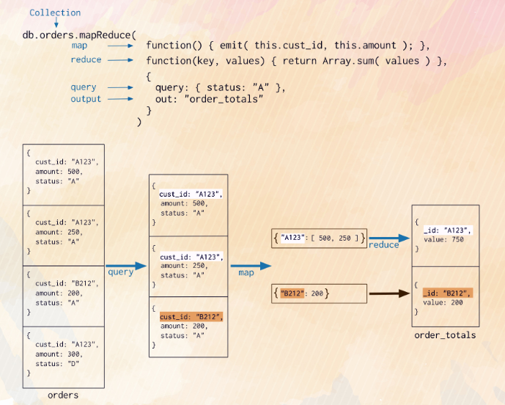
MapReduce Example

Slide 5
MapReduce Syntax
db.collection.mapReduce(
function() {emit(key,value);}, // map function
function(key,values) {return reduceFunction}, // reduce function
{ out: collection }
)

Slide 6
MapReduce Commands
Map: It is a JavaScript function, which is use to generate key-value pairs.
Reduce: A JavaScript function use for grouping all the documents which have the same key.
Out: It specifies the location of map-reduce query output.
Query: We can use it to specify the selection criteria for selecting documents.
Sort: Use for specify sort criteria and optional commands.
Limit: It specifies the number of documents to be returned. It is an optional command to be used.

Slide 7
Example
var mapf=function(){emit(this.subject,this.marks);}
var redf=function(Subject,Marks){return Array.sum(Marks);}
db.student.mapReduce(mapf, redf, {out:”marks”});
db.marks.find() // to see output saved in resultset

Slide 8
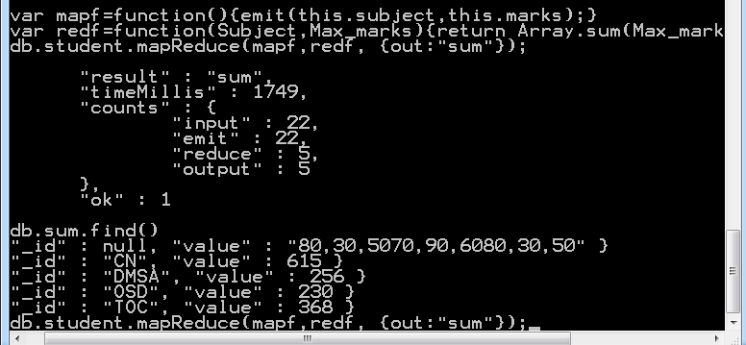
Output

